Slide 1


Neural Network Models for Object Recognition
A presentation on the creation of a neural network using the cifar-10 image dataset for object recognition

Slide 2
Introduction to the assignment
What is the assignment topic?
What are the objectives?

Slide 3
Data handling and preprocessing
What is the CIFAR-10 dataset?
60,000 images total
Metadata information
How was the data partitioned?
Already split into train/test sets
20% of the training data is used for validation
Why is a validation set important?
Hyperparameter tuning
Preventing overfitting

Slide 4
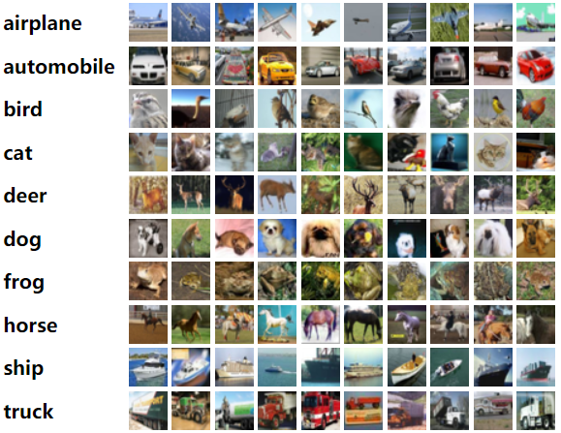
Data handling and preprocessing
Source: https://www.cs.toronto.edu/~kriz/cifar.html

Slide 5
Data handling and preprocessing
What is the CIFAR-10 dataset?
60,000 images total
Metadata information
How was the data partitioned?
Already split into train/test sets
20% of the training data is used for validation
Why is a validation set important?
Hyperparameter tuning
Preventing overfitting

Slide 6
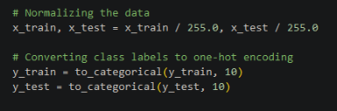
Data handling and preprocessing
CIFAR-10 IMAGE DATA
Testing Data
Training Data
Validation Data

Slide 7
Data handling and preprocessing
What is the CIFAR-10 dataset?
60,000 images total
Metadata information
How was the data partitioned?
Already split into train/test sets
20% of the training data is used for validation
Why is a validation set important?
Preventing overfitting

Slide 8
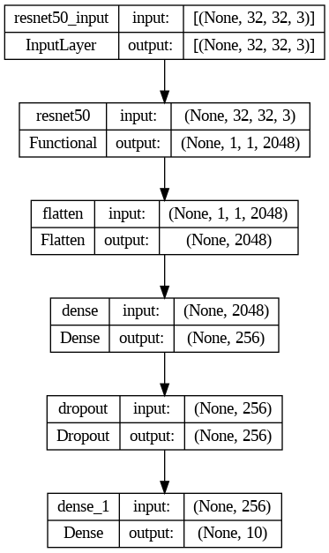
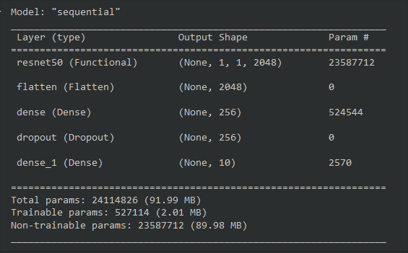
Model Architecture
ResNet neural network
Resnet layers
Functional layer
Flatten layers
Dense layers
Dropout layers
Chosen activation functions:
‘Relu’
‘Softmax’

Slide 9
Model Architecture
ResNet neural network
Resnet layers
Functional layer
Flatten layers
Dense layers
Dropout layers
Chosen activation functions:
‘Relu’
‘Softmax’

Slide 10
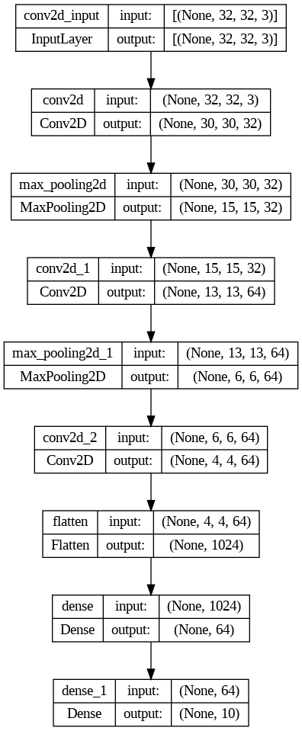
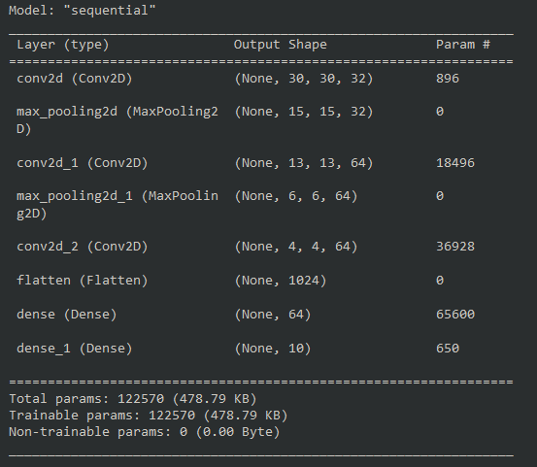
Model Architecture
Convolutional neural network (CNN)
Layers
Chosen activation functions:
‘Relu’
‘Softmax’

Slide 11
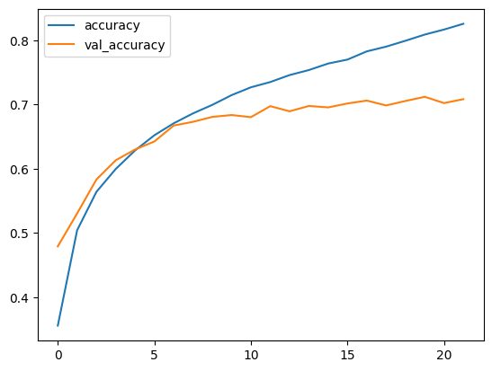
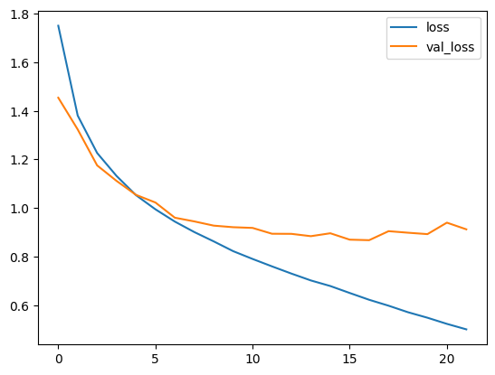
Training and Evaluation
Data training
What was the process?
What were the parameters?
What was the loss function?
Results
Model is 70.4% accurate.
Optimal number of epochs is 22.

Slide 12

Conclusion and reflections
What was learned during this assignment?
What was unexpected?
What was challenging?

Slide 13
References
Brownlee, J. (2020) What is the Difference Between Test and Validation Datasets?. Available from: https://machinelearningmastery.com/difference-test-validation-datasets/ [Accessed 8 July 2024].
Cedric, S. (2018) An investigation of categorical variable encoding techniques in machine learning: binary versus one-hot and feature hashing. Bachelor thesis. KTH Royal Institute of Technology. https://www.diva-portal.org/smash/record.jsf?pid=diva2%3A1259073&dswid=-3197 [Accessed 5 July 2024].
Geeksforgeeks. (2024) Choose Optimal Number of Epochs to Train a Neural Network in Keras. https://www.geeksforgeeks.org/choose-optimal-number-of-epochs-to-train-a-neural-network-in-keras/ [Accessed 12 July 2024].
Gupta, D. (2024) Fundamentals of Deep Learning – Activation Functions and When to Use Them?. Available from: https://www.analyticsvidhya.com/blog/2020/01/fundamentals-deep-learning-activation-functions-when-to-use-them/ [Accessed 10 July 2024].
Hawkins, D. (2004) The Problem of Overfitting. J. Chem. Inf. Comput. Sci 44(1):1–12. DOI: 10.1021/ci0342472 [Accessed 7 July 2024].
James, G., Witten, D., Hastie, T. & Tibshirani, R. (2013) An Introduction to Statistical Learning: with Applications in R. 1st ed. Springer.
Krizhevsky, A. (2009) Learning Multiple Layers of Features from Tiny Images. https://www.cs.toronto.edu/~kriz/learning-features-2009-TR.pdf
Kumar, A. (2020) Keras – Categorical Cross Entropy Loss Function. https://vitalflux.com/keras-categorical-cross-entropy-loss-function/. [Accessed 13 July 2024].
Miao, J., Xu, Shaowu., Zou, Baixian. & Qiao, Yuanhua. (2021) ResNet based on feature-inspired gating strategy. Deep Processing of Multimedia Data. 81():19283-19300. DOI: 10.1007/s11042-021-10802-6 [Accessed 8 July 2024].
Saxena, S. (2024) Introduction to Softmax Activation Function for Neural Network. Available from: https://www.analyticsvidhya.com/blog/2021/04/introduction-to-softmax-for-neural-network/ [Accessed 12 July 2024].
Sola, J. & Sevilla, J. (1997) Importance of input data normalization for the application of neural networks to complex industrial problems. IEEE Transactions on Nuclear Science 44(3):1464-1468. DOI: 10.1109/23.589532 [Accessed 2 July 2024].
Zhao, L. & Zhong, Z. (2024) A improved pooling method for convolutional neural networks. Scientific Reports. 14():1589. Available from: https://www.nature.com/articles/s41598-024-51258-6 [Accessed 14 July 2024].

